Slide 1


How confident do you feel discussing online safety with your child/children?
ⓘ Start presenting to display the poll results on this slide.

Slide 2

ONLINE SAFETY

Slide 3

What is online safety?
Potential risks children face
What are children accessing online?
CONTENTS
Top Tips
Resources and Activities
Questions

Slide 4

WHAT IS
ONLINE SAFETY?
Internet safety is all about staying safe online and being aware of any potential risks we might face, which include malware, scams, and cyberbullying. Children accessing the internet for the first time may be unaware of these risks, which makes teaching internet safety for kids very important.

Slide 5
POTENTIAL RISKS CHILDREN FACE WHEN USING THE INTERNET

Slide 6

Device addiction involves the overuse of smartphones and the internet. Its symptoms include anger and irritability, lack of concentration, and problems sleeping.
We often use smartphones and other devices without paying any attention to the detrimental effects they can have. By limiting our usage of devices, turning off notifications, and monitoring our screen times, we can have a healthier relationship with the internet.
DEVICE ADDICTION

Slide 7
With so many different social media and messaging applications, cyberbullying is one of the most serious issues of internet safety. It’s important that children report any instances of cyberbullying, whether they’re the victim or a witness. To help prevent it from happening, it’s necessary to maintain a dialogue with children about being kind online. Monitoring online activity and creating an environment where talking is easy are both important too.
CYBERBULLYING

Slide 8
The internet can be a valuable tool for finding information or sharing it with others, but because it’s a space where anyone can post and share information, it can be difficult to know who to trust. Lots of information is false and aims to manipulate and distort the truth, and when it’s posted on the internet, it has the potential to impact a lot of people. Only trust information from reliable sources, and teach children to be careful of what they share.
FAKE NEWS

Slide 9
Sharing personal information can leave you vulnerable. Whether you accidentally share bank details with a stranger or your child posts family holiday plans on social media, both instances can have damaging consequences. It’s essential to remain cautious and never post anything that could leave you open to harm. Monitoring children’s usage and talking openly about what not to share on the internet will help too.
JEOPARDISING PERSONAL INFOMATION

Slide 10
Strangers on the internet can try to take advantage of children’s vulnerability, and this can lead to harmful situations both online and in real life. Parents and teachers should regularly talk to children about who they speak to on the internet. Similarly, children who are contacted by a stranger or come across anything that makes them feel uncomfortable or seems untoward should immediately report it to an adult.
SPEAKING TO STRANGERS

Slide 11
Cybercriminals can send emails or messages that appear genuine but actually contain harmful content. Be wary of any email or message that claims to be from an organisation or a friend that seems slightly off or doesn’t include a personal message. Encourage children to ask an adult before they open emails and messages.
SCAMS/ PHISHING

Slide 12
One social media post can have lifelong consequences, regardless of its intentions. Schools, universities, and employers all monitor social media, so an ill-thought-out post carries massive potential risk. Encourage children to be kind and caring on the internet, and stress that what they post can carry serious implications. If they’re unsure about whether to post something, then they probably shouldn’t.
DAMAGING POSTS

Slide 13
Malware refers to harmful software that is often downloaded unknowingly. Malware can allow someone to access personal information or damage your device. It often masquerades as something else, a game, for example. It’s important for children to ask for permission before downloading anything to avoid downloading malware. Good cyber-security software and only downloading from reliable websites will also ensure internet safety.
DOWNLOADING MALWARE

Slide 14

What apps/games/websites do you think your children access?
ⓘ Start presenting to display the poll results on this slide.

Slide 15
WHAT ARE CHILDREN ACCESSING ONLINE?
Module 2
https://nationalonlinesafety.com/hub/view/course/os-for-parents-carers-of-children-aged-7-11

Slide 16
TOP TIPS FOR KEEPING CHILDREN SAFE

Slide 17

HAVE REGULAR CONVERSATIONS ABOUT LIFE ONLINE
Talk openly and frequently about what you are doing online and encourage your child to do the same.
Talk about the positive experiences you can have online, share what you have done when you have come across content you did not want to, and how you dealt with the situation.

Slide 18

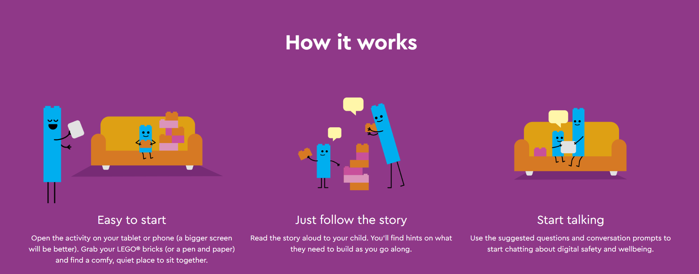
LEGO BUILD AND TALK

Slide 19
ENJOY AND EXPLORE THE ONLINE WORLD TOGETHER
Play games, watch videos, and express an interest in your child’s online life. Celebrate all the opportunities that technology has to offer, and show them what a great space the internet can be when used responsibly.

Slide 20
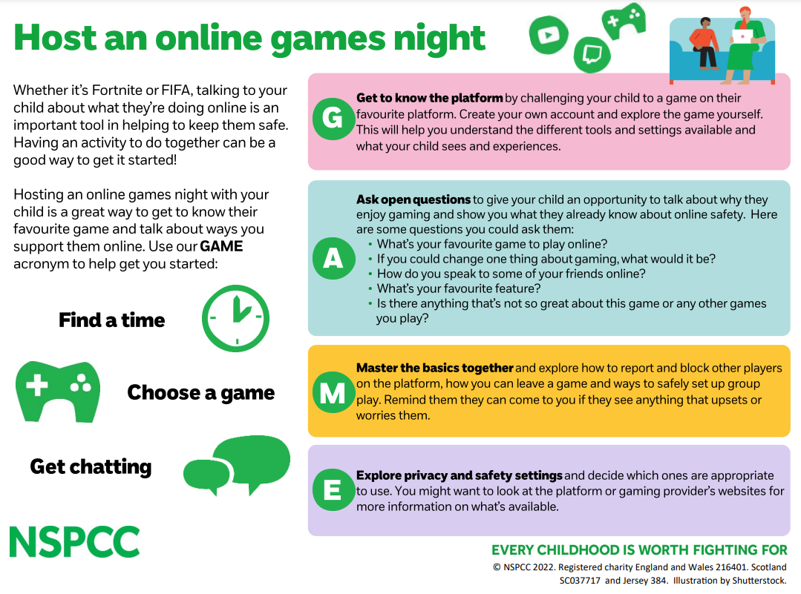

Slide 21
WORK AS A FAMILY TO AGREE EXPECTATIONS FOR GOING ONLINE
Talk to your family about the role technology plays in your lives. Establish rules and expectations that encourage meaningful use of technology, in the same way you set boundaries in other areas of your children’s lives. It’s important to review these regularly and adapt them for each member of your family.

Slide 22
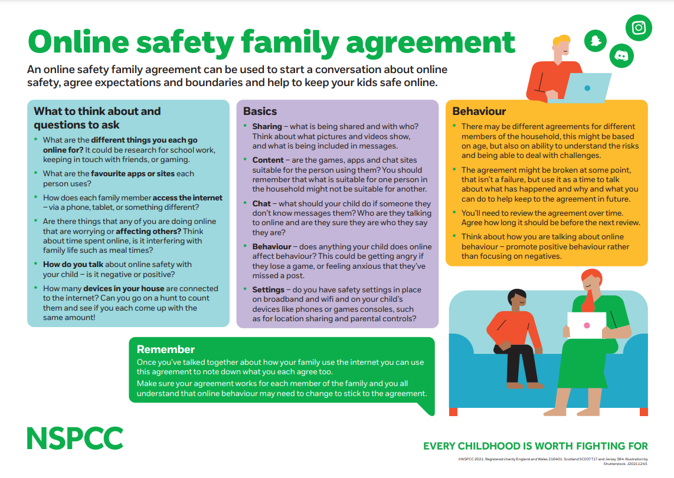

Slide 23
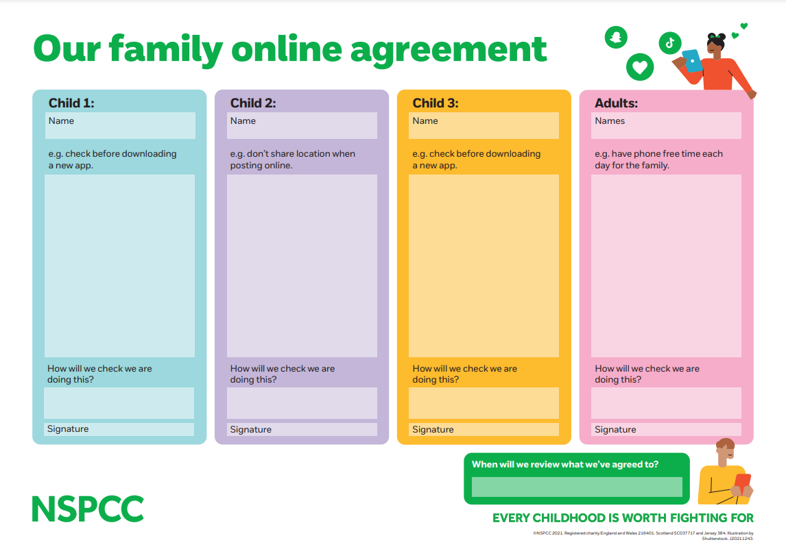

Slide 24
LEARN ABOUT THE APPS, GAMES AND WEBSITES YOUR CHILD IS USING
There are lots of tools and guides to support you with keeping your child safe on whatever apps, games and websites they are using. Research age ratings, privacy settings, and safety features (like the block and report button) so that you are best placed to help your child should anything go wrong.

Slide 25
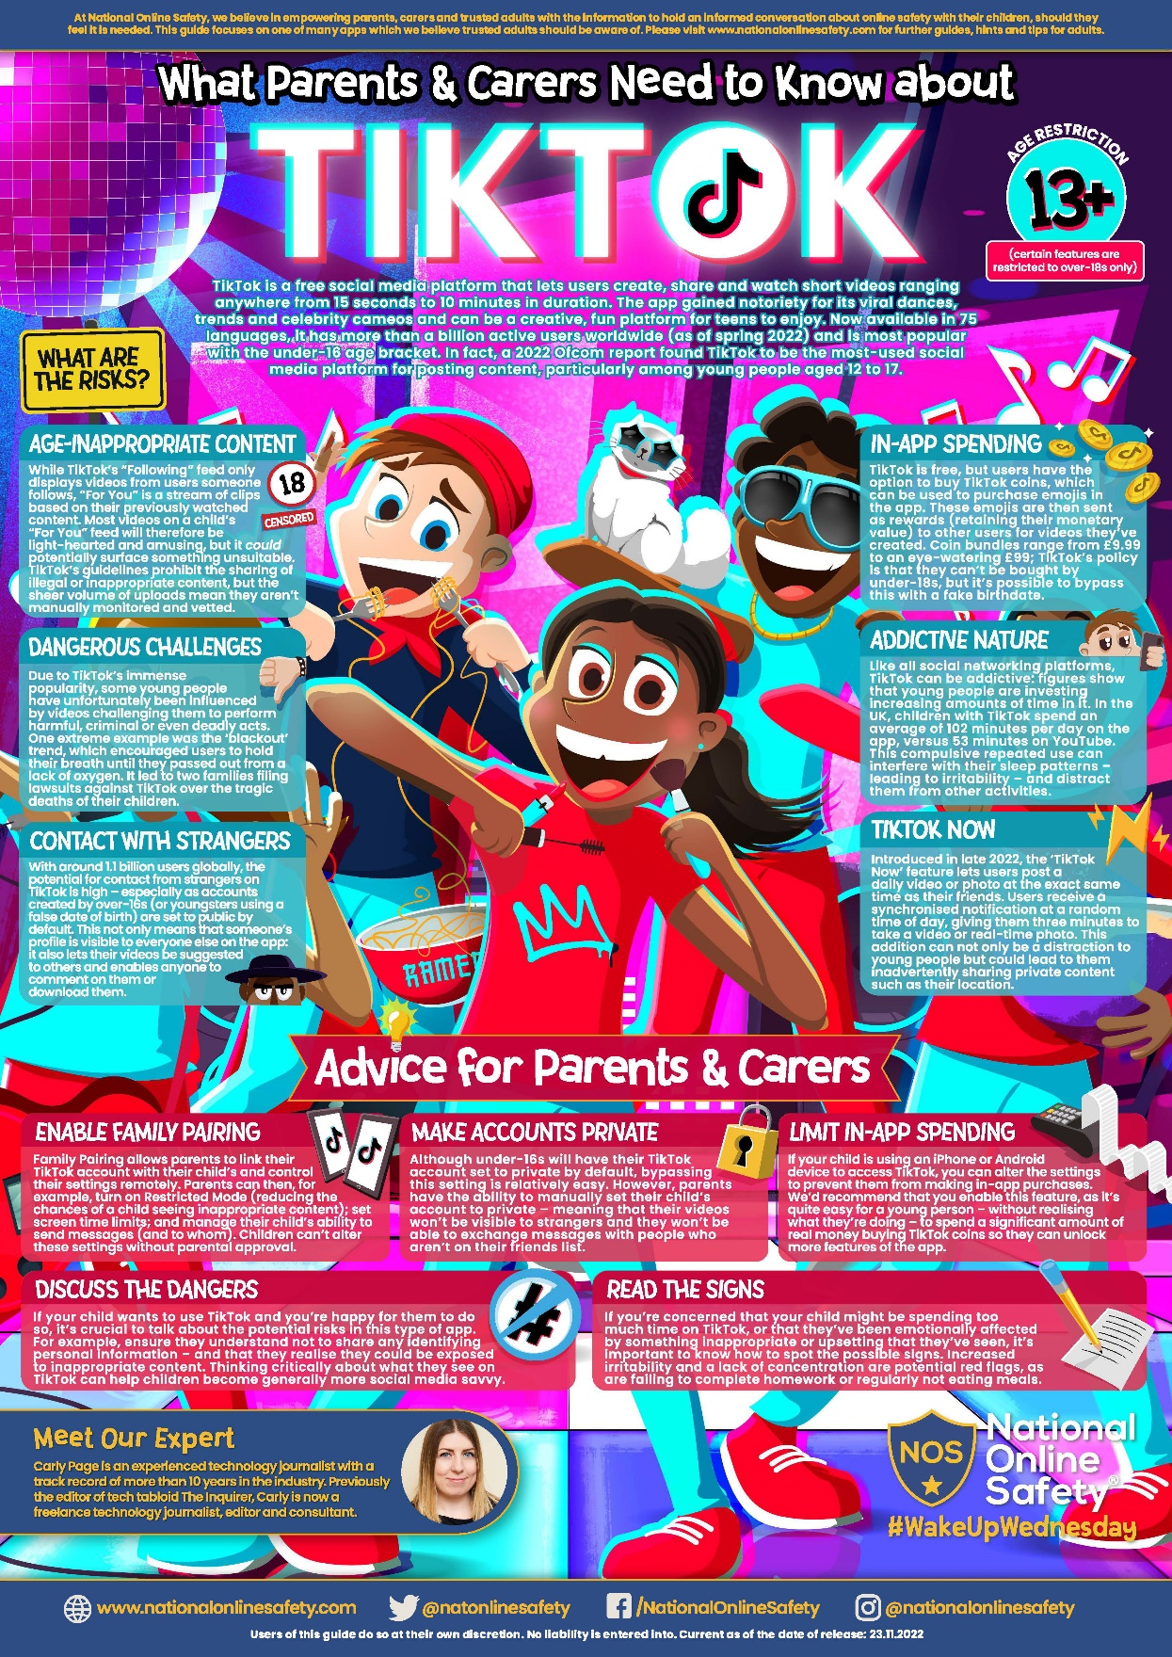

Slide 26
SUPPORT AND REASSURE YOUR CHILD IF THINGS GO WRONG
Remind your child they can talk to you about anything. If something goes wrong, listen and respond with reassurance and kindness and stay calm. Work with your child to find solutions to the problem, perhaps by using the block and report tools or seeking advice from your child’s school.

Slide 27
GOOGLE FAMILY LINK
With Family Link, you decide what’s best for your family. Easy to use tools allow you to understand how your child is spending time on their device, share location, manage privacy settings, and more.
Set screen time limits
Approve or block apps your child wants to download
Protect their privacy – manage permissions on apps and websites
Secure their account – change passwords and infomation
See where they are
Get notifications when your child leaves or arrives at a location

Slide 28
LEGO BUILD AND TALK
Choose one of the booklets and read it through with your child.
This is a great way to start a conversation.
On some pages, there are prompts with questions for you to ask.
Their website also has extra information for you which explains each topic in more detail.
https://www.lego.com/en-gb/sustainability/children/buildandtalk/

Slide 29
STORIES
There are many children's stories which have been written to help teach them about online safety.
Share reading one of the stories with your child.
There are lots of stories available for free online, or in your local library.

Slide 30
GOOGLE GAMES
There are 2 games, created by Google, which are about online safety.
Interland is one game, where you are a little character who travels around different islands and learns about online safety.
https://beinternetawesome.withgoogle.com/en_us/interland
Space Shelter is the other, where you are an astronaut who needs to keep the space shelter safe from digital attacks.
https://spacesheltergame.withgoogle.com/

Slide 31
COMMON SENSE MEDIA
This website gives you up to date information about games, tv shows, films, books, apps and YouTube videos.
It tells you what it is about, some of the different themes that are in it and the age range it is appropriate for.
It is perfect for when you hear your child talk about a new game and you want to find out exactly what it is.
https://www.commonsensemedia.org/

Slide 32
CHILDLINE
Childline is a fantastic website with lots of information for children.
They have an area dedicated to Online Safety with tips your child/children should use.
https://www.childline.org.uk/info-advice/bullying-abuse-safety/online-mobile-safety/staying-safe-online/

Slide 33
PARENTAL CONTROL
This website gives you lots of information on setting up and using parental controls.
You can choose your child’s specific device you want to use parental controls on and it will take you through, step by step, on how to set it up.
https://www.internetmatters.org/parental-controls/
There are many other fantastic resources on the interet matters website.

Slide 34
FAMILY GAMING DATABASE
This website helps you and your faily find board games and video games which suit your ages and interests.
Click on Game Finder and go though the questions to find a selection of game recommendations.
Some games you then have to buy, others are free either online or as apps.
https://www.taminggaming.com/en-gb/home

Slide 35
GOOGLE FAMILY LINK
The Google family link website provides more information on the features it has, and how to set it up.
All you need, is a google account for each person in your family. These are free and easy to set up.
https://families.google/familylink/

Slide 36
NSPCC
The NSPCC website has lots of helpful information about staying safe online.
Online games - https://www.nspcc.org.uk/keeping-children-safe/online-safety/online-games/
Social media - https://www.nspcc.org.uk/keeping-children-safe/online-safety/social-media/
Internet connected devices - https://www.nspcc.org.uk/keeping-children-safe/online-safety/internet-connected-devices/
Livestreaming - https://www.nspcc.org.uk/keeping-children-safe/online-safety/livestreaming-online-video-apps/

Slide 37
NATIONAL ONLINE SAFETY POSTERS
The National Online Safety posters are sent out on Parent app each week.
Some give information about a specific website, app or game, while others look at different topics like online bullying or setting up new devices

Slide 38
SAFER INTERNET CENTRE
The Safer Internet Centre is the company that organize safer internet day.
Their website has lots of information about staying safe online, including guides about using and discussing different typs of devices.
https://saferinternet.org.uk/guide-and-resource/parents-and-carers

Slide 39
QUIZ
Have a go at the Online Safety quiz.
The answers are at the bottom on the back.
See if you can get all of them correct.

Slide 40
BOUNCE SURVEY
Please could you complete the bounce survey for this workshop.
All feedback is greatly appreciated and can help improve other sessions.
https://app.bouncetogether.co.uk/shrt/I5NS2OXPK0

Slide 41
Which resource do you think is the most helpful?
ⓘ Start presenting to display the poll results on this slide.

Slide 42

THANK YOU!

