Slide 1
QUICK DRAW
This is a game built with machine learning. You draw, and a neural network tries to guess what you’re drawing.
It was made as an example of how machine learning can be used.
https://quickdraw.withgoogle.com/

Slide 2
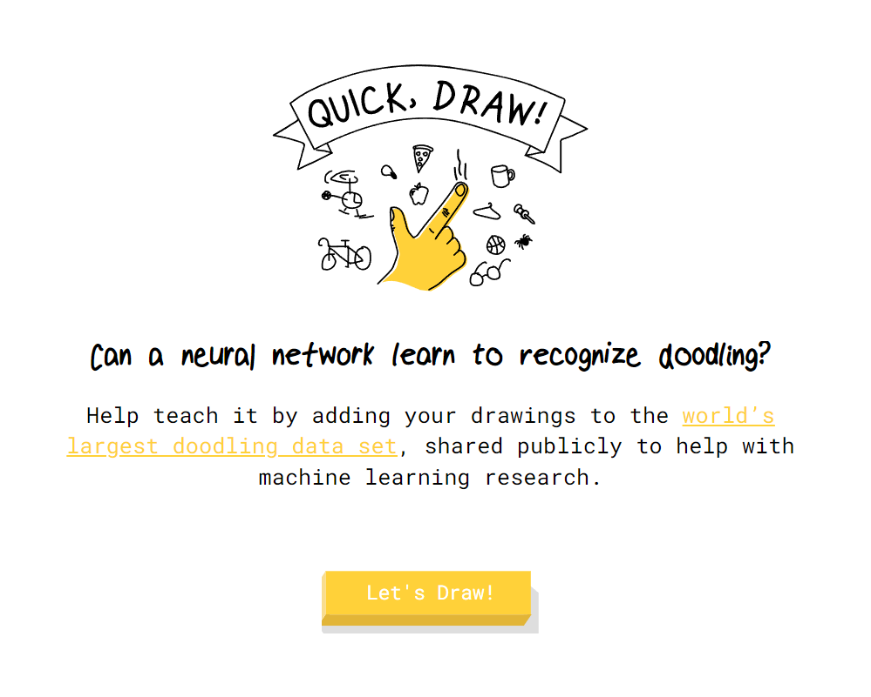
https://quickdraw.withgoogle.com/

Slide 3
ARTBOT
In this game you have an AI helper that you have to train. It demonstrates AI supervised and reinforcement learning.
https://art-bot.net/game/

Slide 4
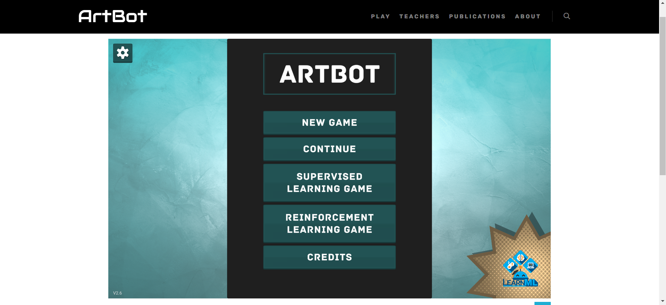
https://art-bot.net/game/

Slide 5
SEMANTRIS
This is a set of word association games powered by machine learning. There are 2 games to play.
https://research.google.com/semantris/

Slide 6
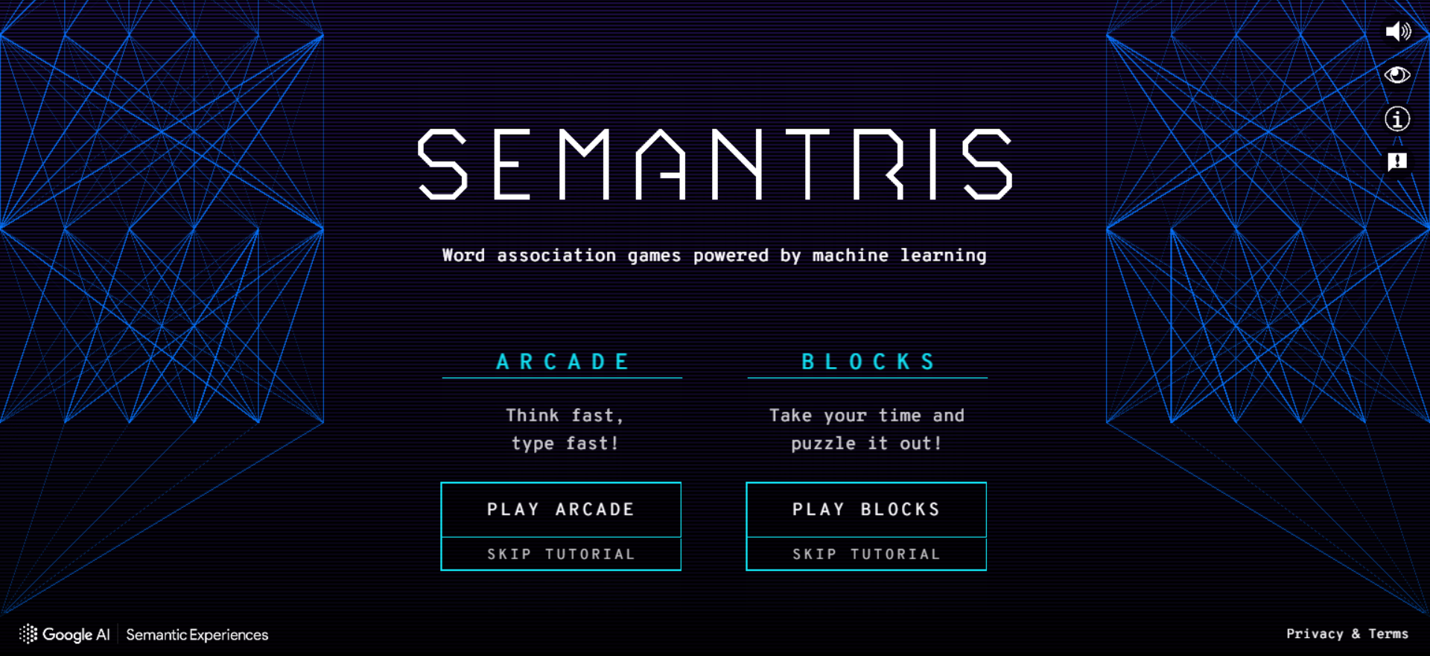
https://research.google.com/semantris/

Slide 7
AI DUNGEON
This is a text based story creator. You choose a genre and it starts the story. It will then prompt you to think of what your character might do and continues writing it for you.
https://play.aidungeon.com/

Slide 8
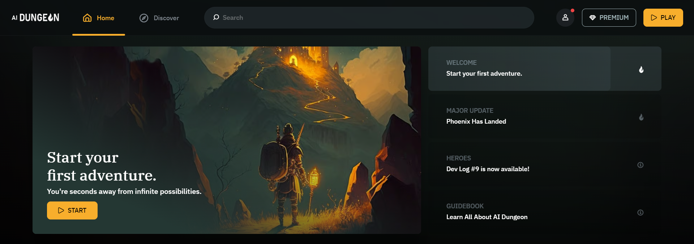
https://play.aidungeon.com/

Slide 9
SKETCH-RNN
This is another drawing game which shows machine learning.
You start to draw a given object and it will predict what your next step will be based on what other people did.
https://magenta.tensorflow.org/assets/sketch_rnn_demo/index.html

Slide 10
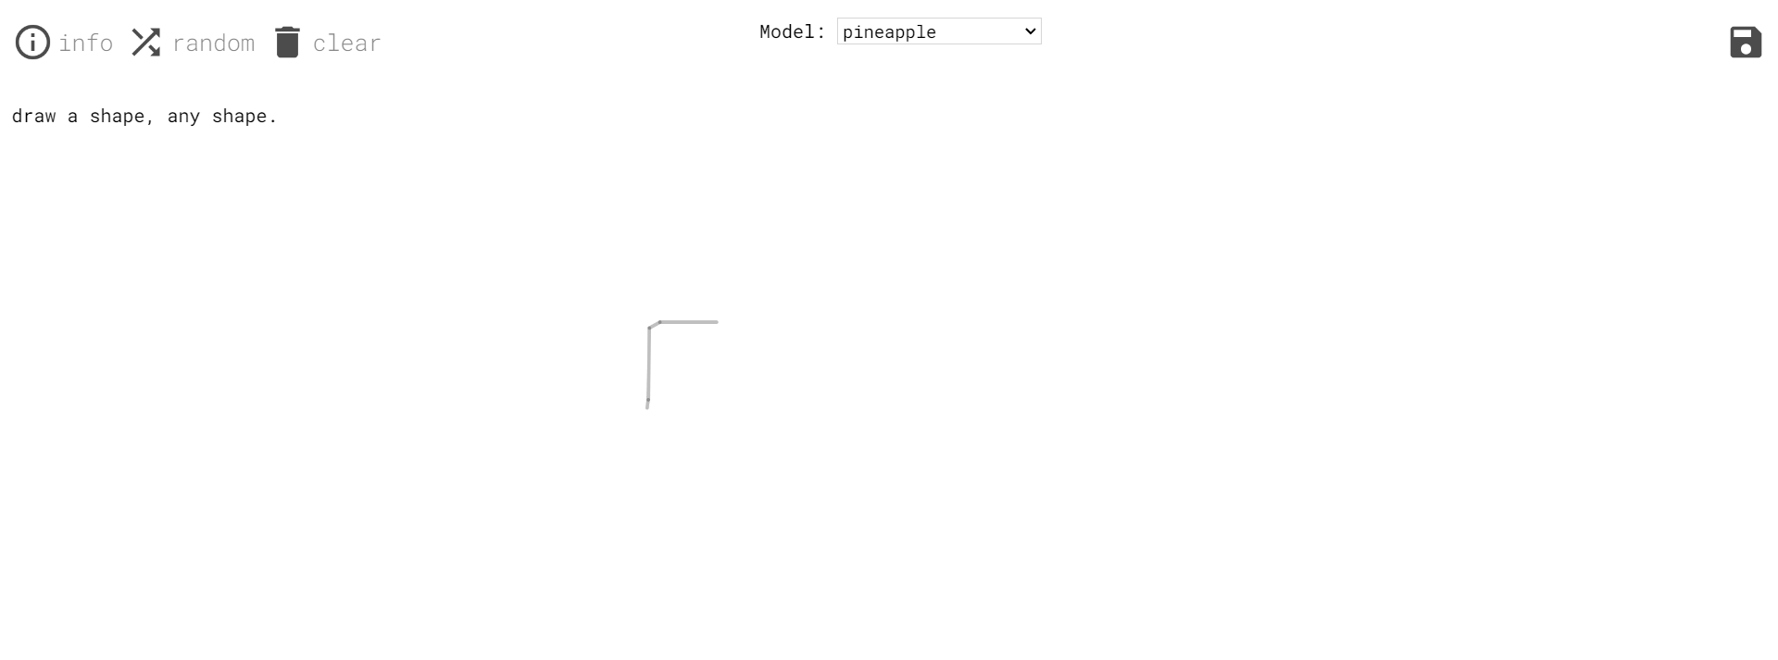
https://magenta.tensorflow.org/assets/sketch_rnn_demo/index.html

Slide 11
MACHINE LEARNING FOR KIDS
This is a website which allows children to create their own AI powered things.
https://machinelearningforkids.co.uk/
Code Club has step by step instructions on how to make things using it.
https://projects.raspberrypi.org/en/pathways/scratch-machine-learning

Slide 12
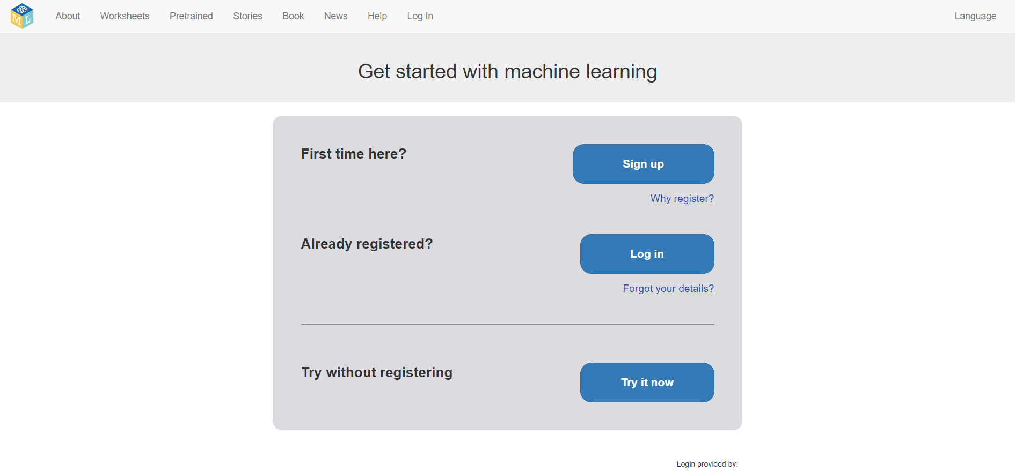
https://machinelearningforkids.co.uk/

Slide 13
AUTODRAW
This AI system is linked to quickdraw. It allows you to make posters, using copyright free images. You draw what you want and select one of the images it suggests.
https://www.autodraw.com/

Slide 14
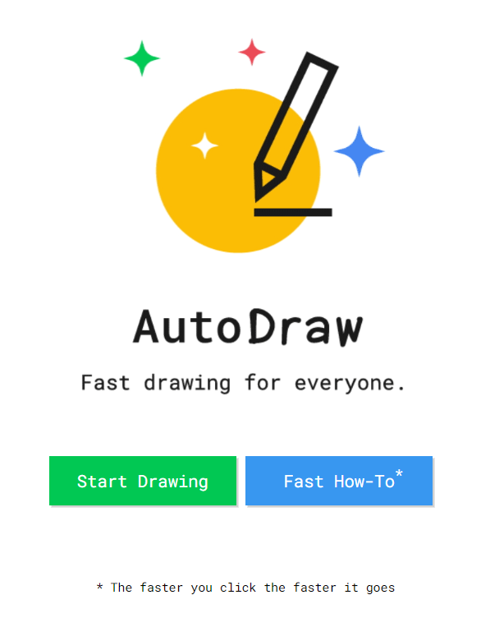
www.autodraw.com/

Slide 15
HEY SIRI
Not a game, just an activity using AI.
Ask Siri the different questions and write down the responses.

Slide 17
BOUNCE SURVEY
I would appreciate if you could do the survey. It helps to make these sessions better and more useful.

Slide 18

BOUNCE

